Slide 1
Create a REST API with Attribute Routing in ASP.NET Web API 2

Slide 2
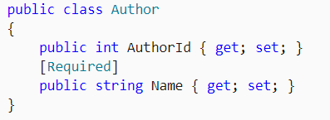
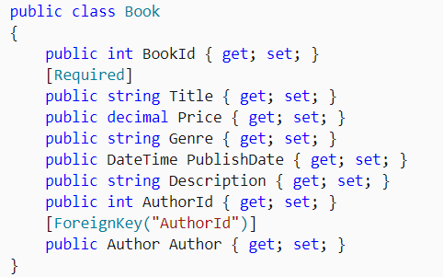
Models
Author
Book

Slide 3
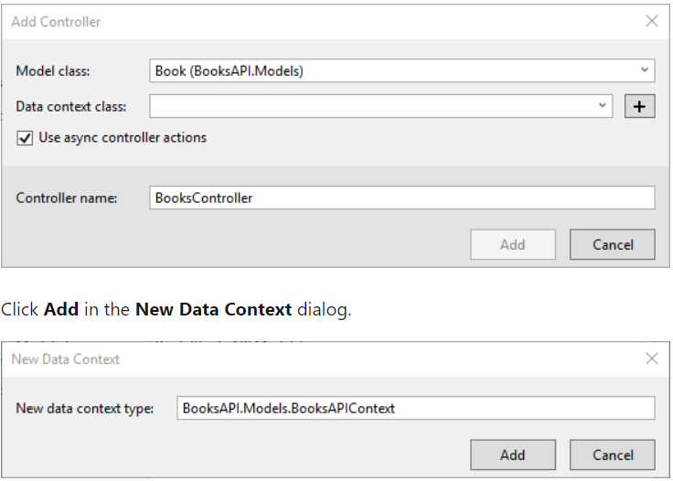
Add a Web API Controller
select Web API 2 Controller with actions, using Entity Framework.

Slide 4
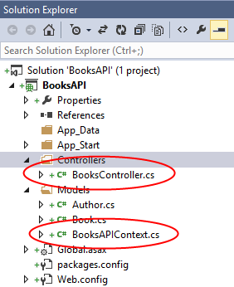
The scaffolding adds a class named BooksController that defines the API controller.
It also adds a class named BooksAPIContext in the Models folder, which defines the data context for Entity Framework.

Slide 5
Seed the Database
select NuGet Package Manager, and then select Package Manager Console.
Add-Migration
This command creates a Migrations folder and adds a new code file named Configuration.cs.
Open this file and add the following code to the Configuration.Seed method.

Slide 6
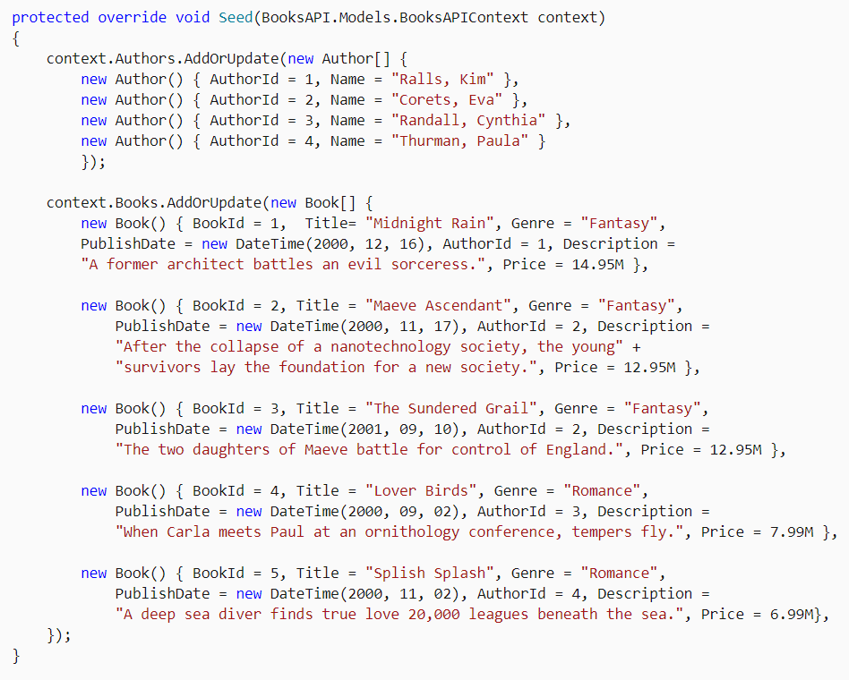
Configuration.Seed method
add-migration Initial
update-database

Slide 7
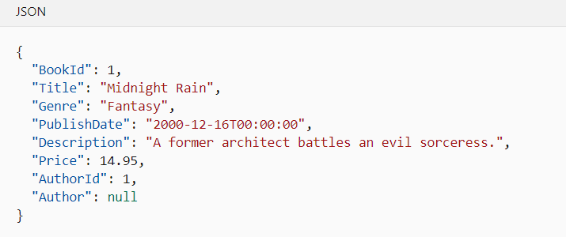
send a GET request to /api/books/1, the response looks :

Slide 8
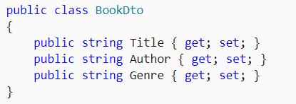
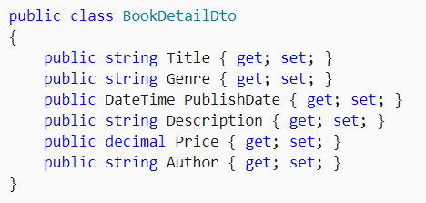
Add DTO Classes (data transfer object )

Slide 9
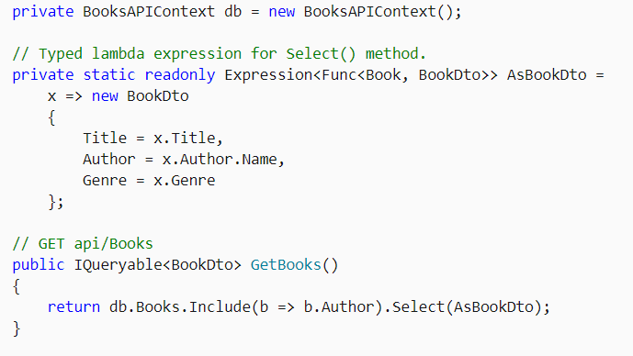
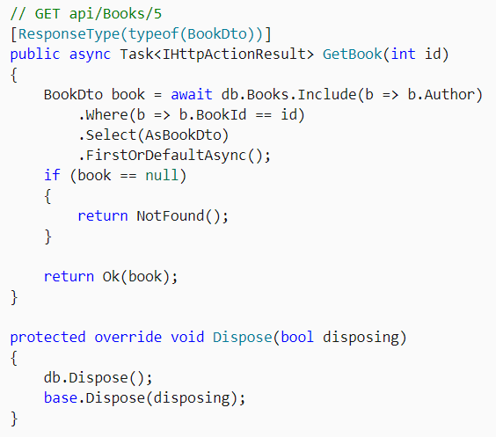

BooksController

Slide 10
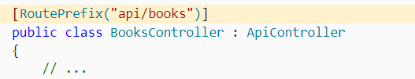
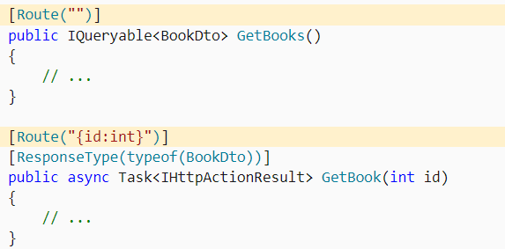
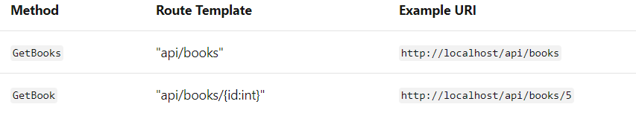
Add Route Attributes

Slide 11
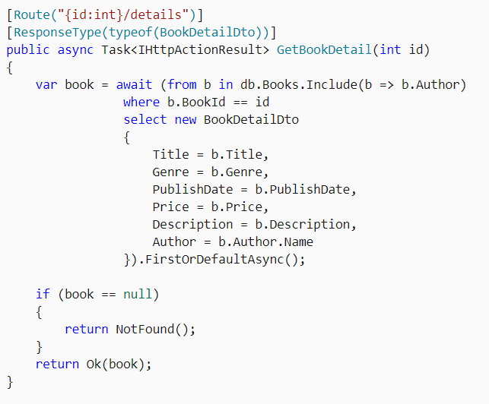
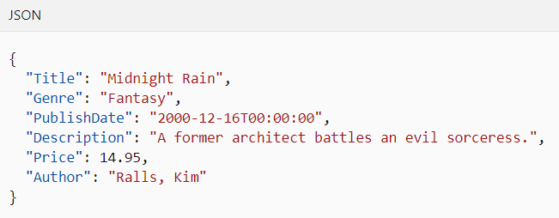
Get Book Details

Slide 12
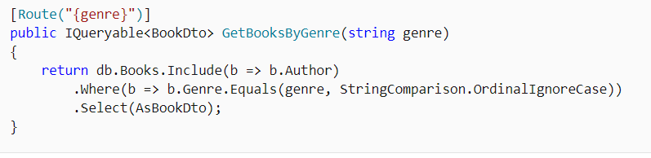
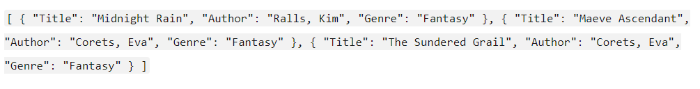
Get Books By Genre

Slide 13
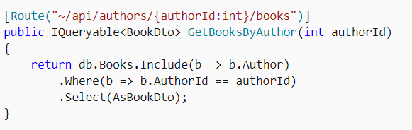
Get Books By Author

Slide 14
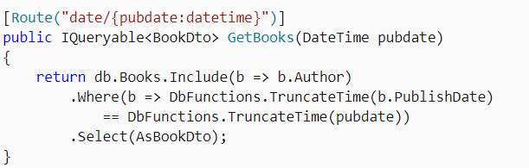
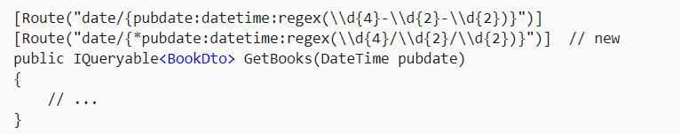
Get Books By Publication Date

